Slide 1
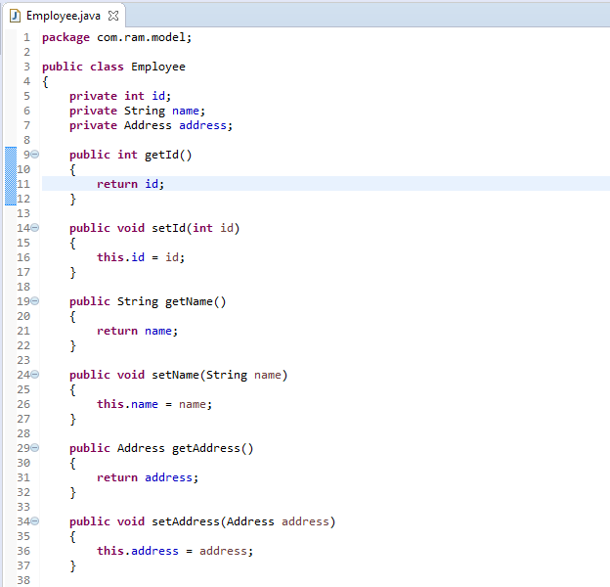
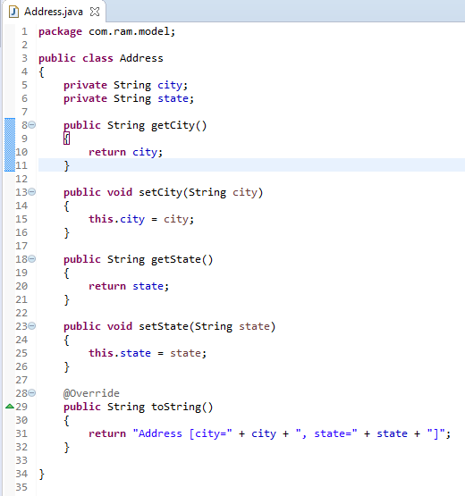

Spring inner bean – Setter Injection

Slide 2
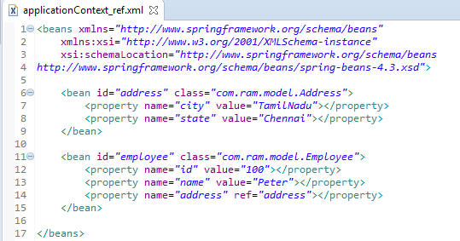
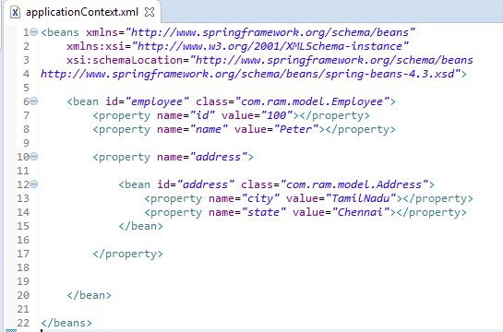
Spring inner bean – Setter Injection
In Spring framework, whenever a bean is used for only one particular property, it’s advise to declare it as an inner bean. And the inner bean is supported both in setter injection ‘property‘ and constructor injection ‘constructor-arg‘.
In general, it’s fine to reference like this, , but since the ‘TamilNadu’ address bean is only used for employee bean only, it’s better to declare this TamilNadu’ address bean as an inner bean as below
1
Often times, we may use ‘ref‘ attribute to reference the “address” bean into “employee” bean, address property
1
2

Slide 3
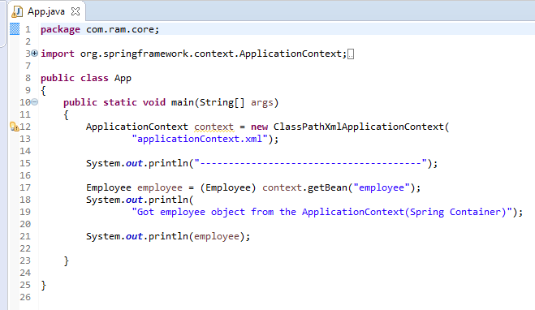
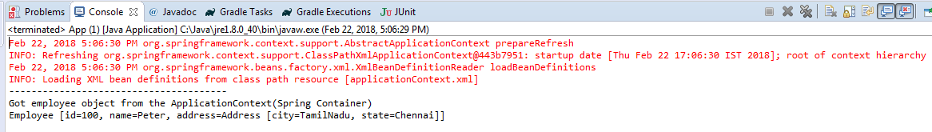
Spring inner bean – Setter Injection

